Slide 1

Bonrix Software Systems: Empowering Business with Smart IT Solutions
Pioneering integrated hardware-software solutions for the digital business era

Slide 2





Breakthrough Innovation: Dynamic QR Code Display Technology
Real-Time Updates
Enhanced Engagement
Smart Record-Keeping
Enable instant content updates for retail displays, hospitality venues, and event spaces—keeping information current without manual intervention.
Seamlessly integrate digital payments including BHIM UPI, creating frictionless customer experiences that boost conversion rates.
Automatically capture transaction records and generate comprehensive business reports for informed decision-making.

Slide 3
Bonrix Cloud POS: Industry-Specific Point of Sale Solutions
Tailored systems designed for diverse hospitality and retail environments
Cafés & Restaurants
Speciality Food Retail
Multi-Store Operations
Full-service and fast-food POS with table management, kitchen display systems, and order tracking.
Custom solutions for ice cream parlours, fresh produce markets, and artisan food businesses.
Cloud-based architecture with real-time inventory synchronisation across multiple locations.
Real-time inventory tracking and supplier management
Customer loyalty programmes and staff analytics
Multi-platform support: Android, iOS, Windows
Access your business data anytime, anywhere with secure cloud synchronisation and offline capabilities.
Monitor stock levels automatically, receive low-stock alerts, and streamline ordering processes.
Build lasting relationships with rewards systems whilst tracking employee performance metrics.

Slide 4
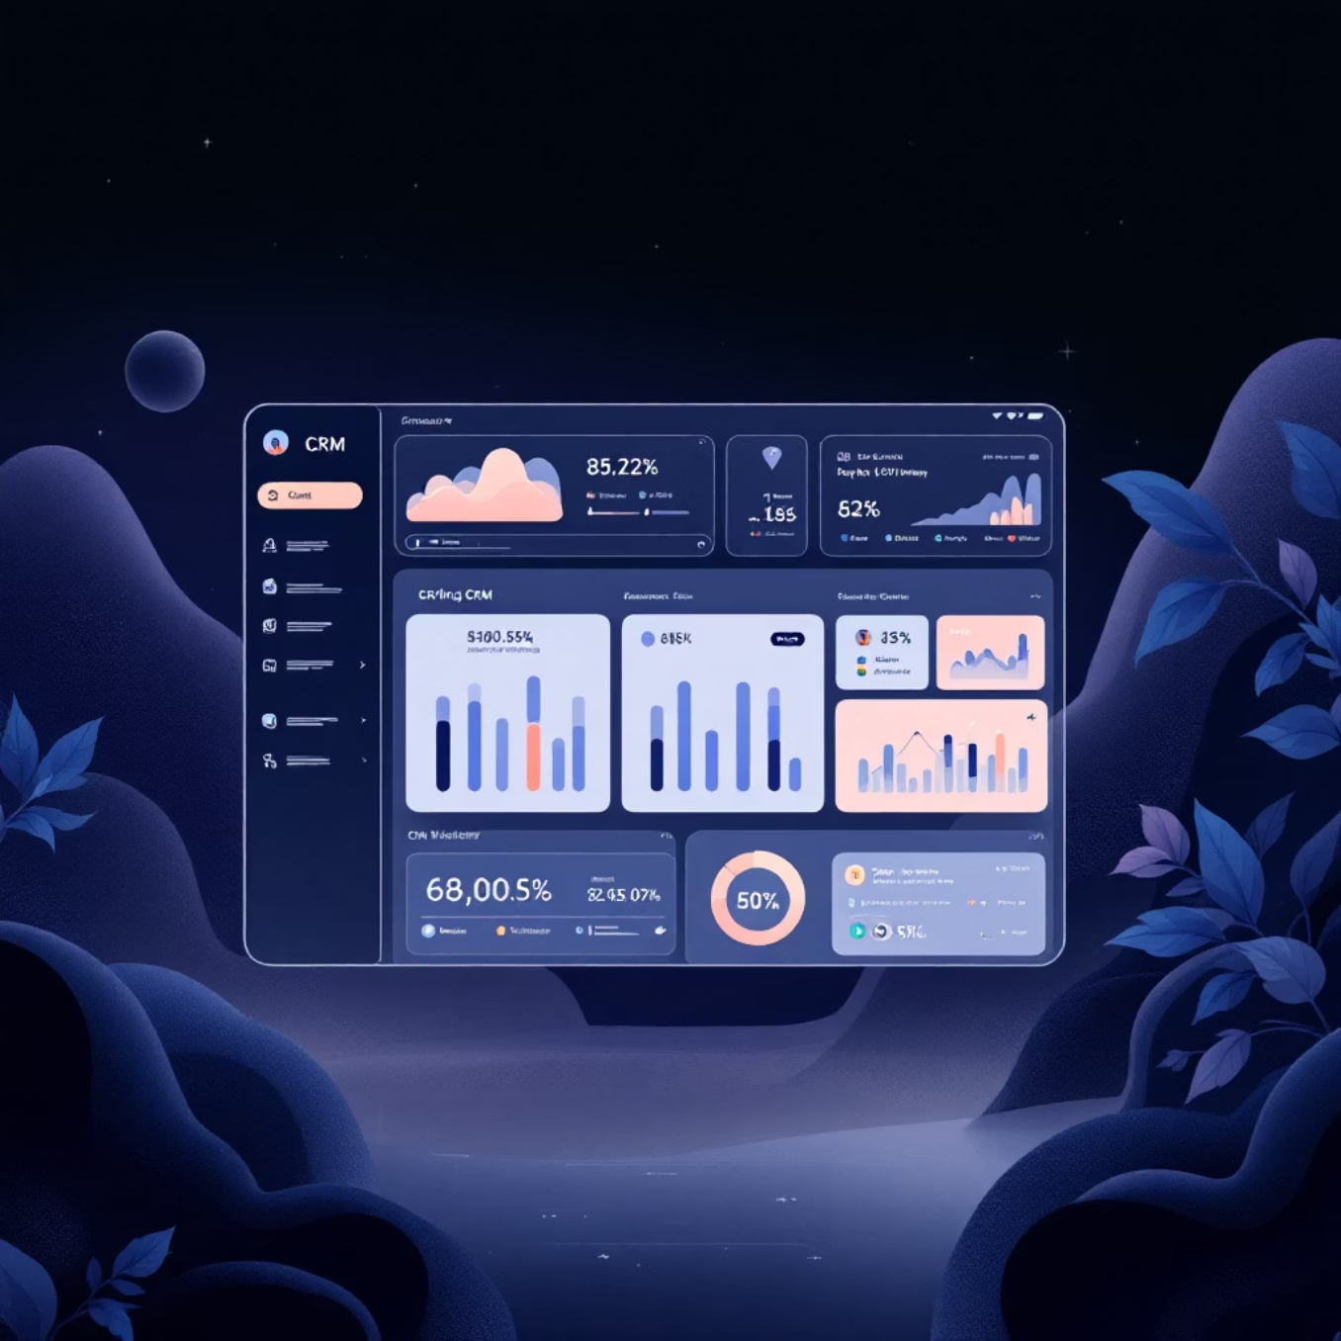
Bonrix CRM: Advanced Lead & Sales Management
Transform Your Sales Pipeline
Our Android-based CRM application streamlines the entire customer journey, from first contact through to conversion and beyond.
01
Efficient Call Processing
Handle inbound and outbound calls with integrated diallers and automatic call logging.
02
Bulk Lead Management
Upload thousands of leads instantly with SMS and email integration for immediate engagement.
03
Pipeline Visibility
Visualise your entire sales funnel with detailed reporting and forecasting tools.
04
Smart Automation
Role-based access controls and workflow automation enhance team productivity by 40%.

Slide 5

Voice & Bulk Communication Solutions
Bonrix Voice Broadcast Web Panel
Multi-Device Compatibility
Deploy sophisticated voice marketing campaigns, OTP notifications, and automated customer alerts at scale. Our platform supports comprehensive reseller management with white-label capabilities.
Seamlessly integrates with VoIP devices, GSM gateways, and Android applications for maximum flexibility in bulk voice campaign deployment.
Omnichannel Communication
Enable powerful multi-channel communication strategies combining voice, SMS, and email for both marketing initiatives and critical transactional alerts.

Slide 6
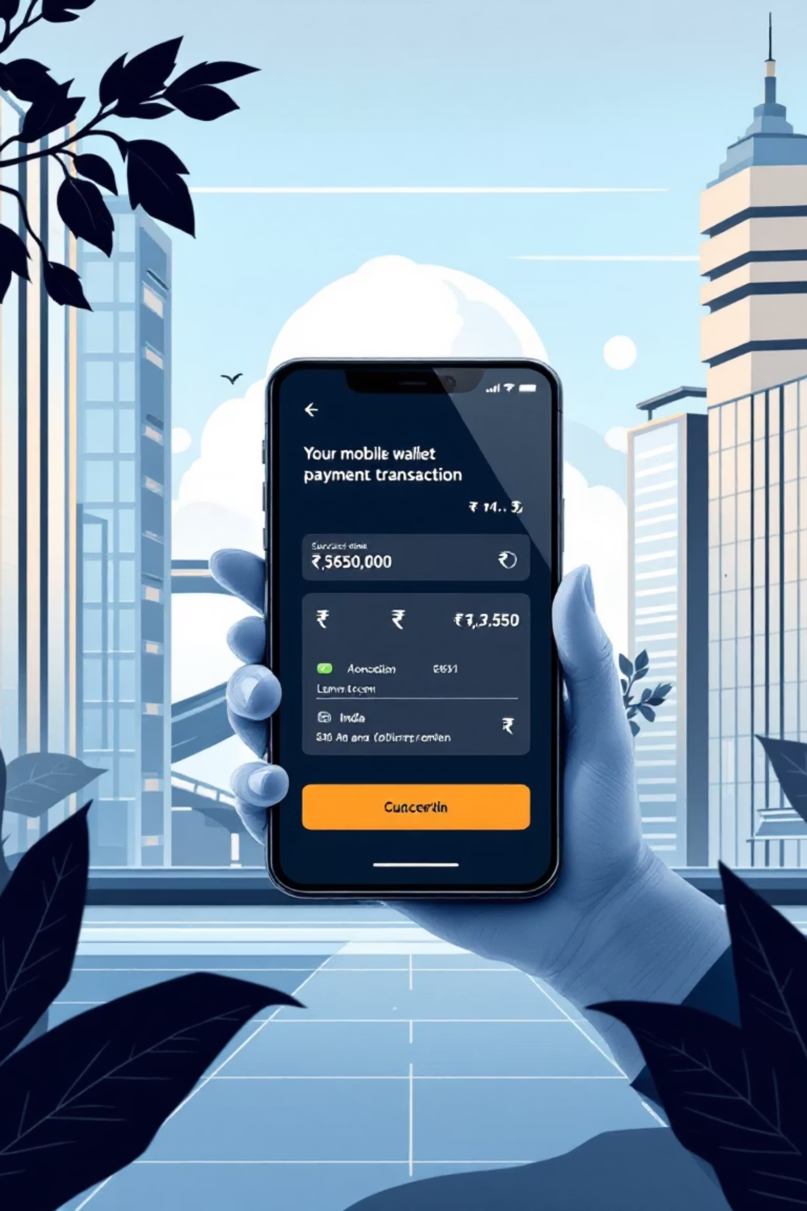
Mobile Recharge & Payment Gateway Systems
Comprehensive digital payment infrastructure for modern businesses
B2C & B2B Platforms
Financial Services Suite
Robust recharge systems with seamless integration of major payment gateways including ICICI, Razorpay, and Paytm.
Complete AEPS, BBPS, Micro ATM, and DMR money transfer capabilities with instant commission settlements.
Retailer Advantages
Provide retailers with a reliable alternative to mainstream apps featuring enhanced discounts and express recharge options.

Slide 7
Key Features & Benefits at a Glance
Inventory Management
Staff Management
Real-time stock tracking, barcode scanning, supplier management, and multi-store synchronisation.
Employee scheduling, performance analytics, role-based access, and attendance tracking.
Customer Loyalty
Offline Capabilities
Points programmes, discount management, promotional campaigns, and gift card systems.
Continue operations without internet, automatic sync when reconnected, zero downtime.
Custom Receipts
Advanced Analytics
Branded receipts, multiple templates, email and SMS delivery, digital receipt storage.
Comprehensive reporting dashboards, sales forecasting, trend analysis, and data-driven insights.

Slide 8

Market Impact & Client Success
Trusted Globally, Rooted Locally
Bonrix has earned the trust of SMEs and enterprises worldwide by delivering scalable, cost-effective IT solutions that drive genuine business transformation.
Under the visionary leadership of founder Renish Ladani, we combine deep local expertise with international quality standards, ensuring our clients receive world-class technology backed by exceptional support.
"Bonrix solutions have transformed our operations. The reliability, ease of use, and comprehensive support are unmatched in the industry."
Strong client feedback consistently highlights our commitment to excellence, innovative approach, and dedication to long-term partnership success.

Slide 9




The Future with Bonrix
AI/ML Innovation
Expanding our product line with face recognition, object detection, and intelligent chatbots powered by advanced machine learning.
IoT Integration
Enhancing embedded solutions for smarter business automation, connecting devices seamlessly for operational excellence.
Global Vision
Becoming the leading Indian IT innovator delivering seamless, integrated business technologies to enterprises worldwide.
Discover how Bonrix can transform your business at bonrix.in
Contact : 9429045500 , 9426045500
Emial : bonrix@gmail.com

